Slide 1
Why Design?
Notes:
Every design or application has
Function
Non- Functional (Maintainablity,scalability,realiabilty,decoupling)
You should not start an application immediately but plan a solution for the problem.
The Solution plan is called a design.
A Good design is very important for successful exectuion of projects.
--------------------------------------
When designing and developing different applications, we come across various problems. As a result, we end up finding new solutions for similar problems.
To save time and effort, we should keep some proven solution to common problem areas.
Such common soltutions are called Design patterns.
----------------------------------------

Slide 2
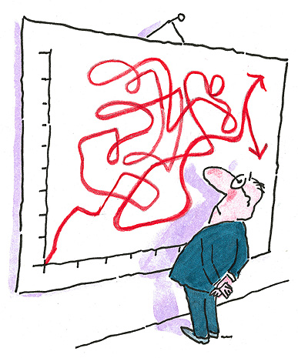

Bad Design
Results in bad performance

Slide 3

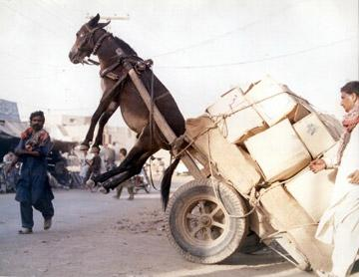
Good Design vs Bad Design
Perform well even
when overload

Slide 4
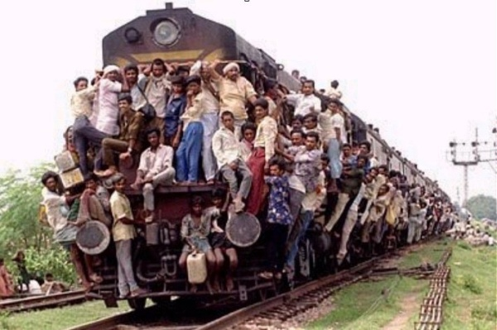
Good Design vs Bad Design
Scalability
Reliability
Availability

Slide 5

Good Design vs Bad Design
Decoupled
Maintainable
Extensible
Flexible
Notes:
Decoupled- to cause to become separated, disconnected, or divergent; uncouple.

Slide 6

Good Design vs Bad Design
Understandability
Readability
Clarity
Well documented for changes

Slide 7
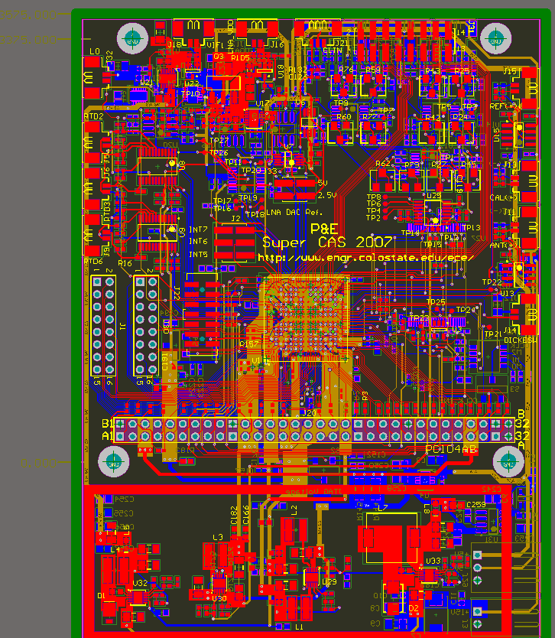
Good Design vs Bad Design
Traceability
Testability

Slide 8

Good design vs Bad design
User Friendliness

Slide 9

J2EE Architecture.........
N- Tiers
Multi - layers

Slide 10

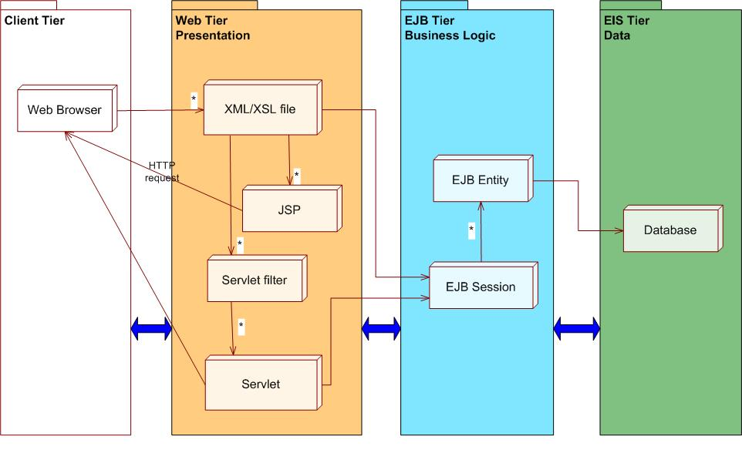
Multi layered Architecture

Slide 11
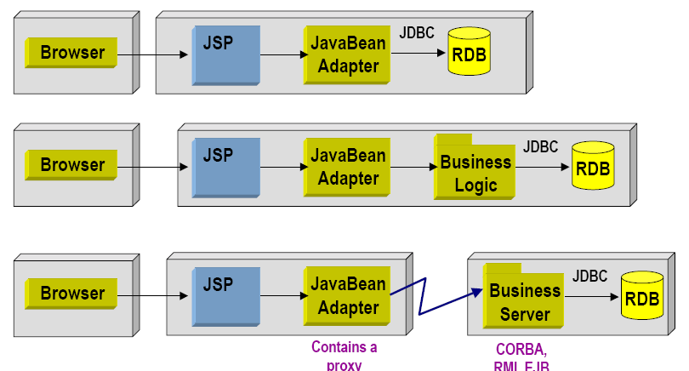
Layering

Slide 12
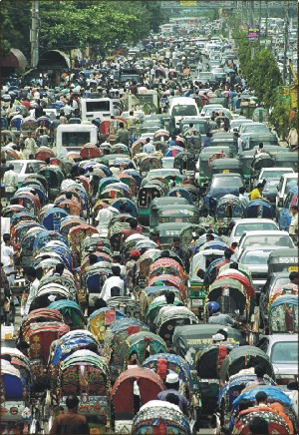
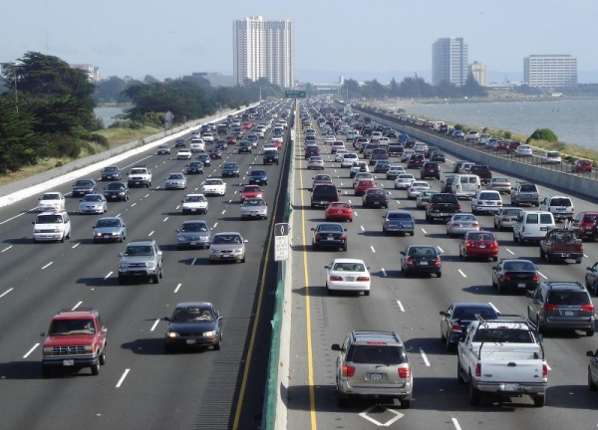
Multi Tiered architecture

Slide 13
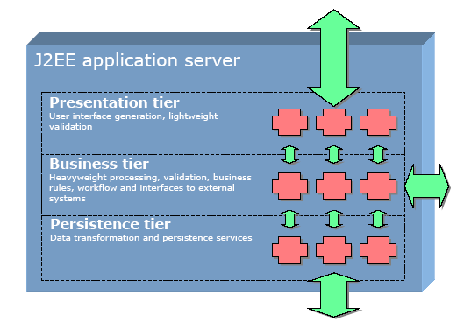
Typical J2EE Architecture

Slide 14
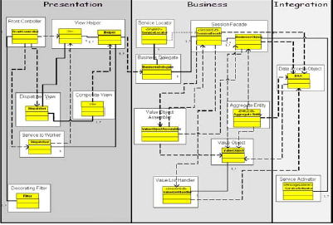
Logical Layering

Slide 15
J2EE DESIGN PATTERNS
what is design pattern?
We can say a design pattern is simply a description of a recurring solution to a problem, in given context.
The context is the environment, surroundings, situation, or interrelated conditions within which the problem exists.

Slide 16
why do need to use design patterns?
Design patterns have a number of advantages like -
1. Once described, any level engineer can use the pattern.
2. They allow for reuse without having to reinvent in every a project.
3. They allow to better define system structure.
4. They provide a design vocabulary.
5. They provide reusable artifacts.
6. Patterns can form frameworks that can then be used for implementations.

Slide 17
What is a context? »A context is the environment, surroundings, situation or interrelated conditions within which something exists.
What is a problem? »A problem is an unsettled question, something that needs to be investigated and solved. Typically, the problem is constrained by the context in which it occurs.
What is a Solution? » Refers to the answer to the problem in a context that helps to resolve the issues.

Slide 18
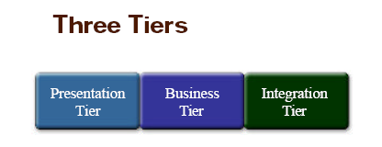
J2EE Design Patterns: The Tiered Approach

Slide 19
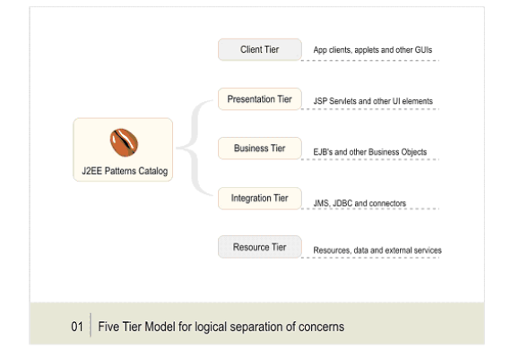
Five Tier model for logical separation of concerns
Each tier is assigned its unique responsibility in the system. You view each tier as logically separated from one another. Each tier is loosely coupled with the adjacent tier.

Slide 20
Client Tier :
This tier represents all device or system clients accessing the system or the application. A client can be a Web browser, a Java or other application, a Java applet, a WAP phone, a network application, or some device introduced in the future. It could even be a batch process.
Presentation Tier :
This tier encapsulates all presentation logic required to service the clients that access the system. The presentation tier intercepts the client requests, provides single sign-on, conducts session management, controls access to business services, constructs the responses, and delivers the responses to the client. Servlets and JSPs reside in this tier. Note that servlets and JSPs are not themselves UI elements, but they produce UI elements.

Slide 21
Business Tier :
This tier provides the business services required by the application clients. The tier contains the business data and business logic. Typically, most business processing for the application is centralized into this tier. It is possible that, due to legacy systems, some business processing may occur in the resource tier. Enterprise bean components are the usual and preferred solution for implementing the business objects in the business tier.
Integration Tier :
This tier is responsible for communicating with external resources and systems such as data stores and legacy applications. The business tier is coupled with the integration tier whenever the business objects require data or services that reside in the resource tier. The components in this tier can use JDBC, J2EE connector technology, or some proprietary middleware to work with the resource tier.

Slide 22
Resource Tier :
This is the tier that contains the business data and external resources such as mainframes and legacy systems, business-to-business (B2B) integration systems, and services such as credit card authorization.

Slide 23
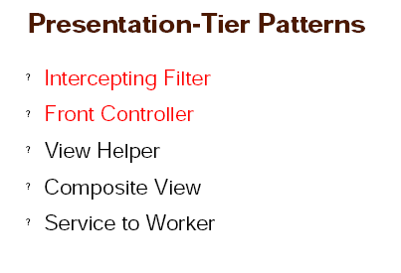
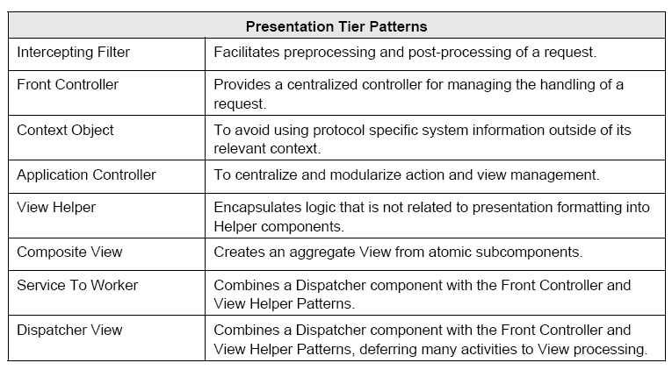

Slide 24

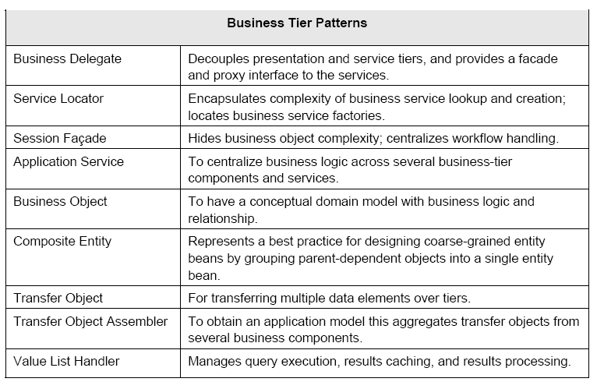

Slide 25

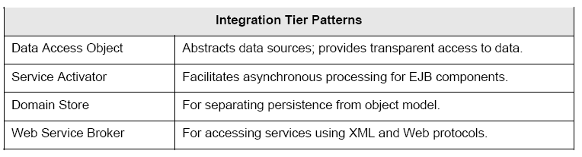

Slide 26

Lets have some fun with pattern!!

Slide 27
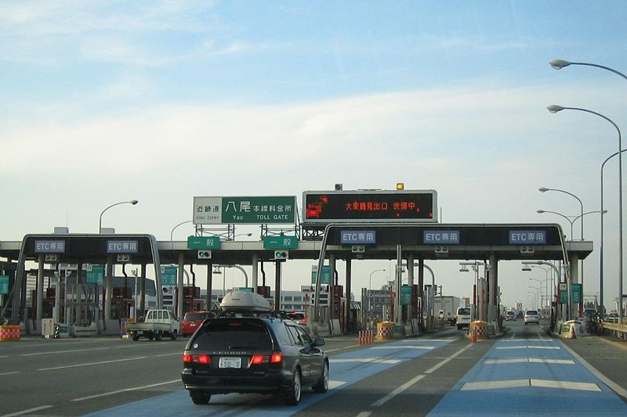

Front Controller
It provides a centralized controller for managing the handling of a request.
Notes:
Definition
Using a single component to process application requests.
Where to use & benefits
JSP or Servlet.
Design request handling component.
Channel all requests through a single controller.
Centralize request processing and view selection.
Reduce business logic in a view
Improve manageability of security
Promote code reuse across requests
Avoid code duplication
Related patterns include
Command combined with multiple requests.
Intercepting Filter both centralize control of certain types of request processing.
Page Controller -- an alternative way.
Example
Design a servlet to deal with all the requests.

Slide 28
Front Controller
Model-View-Controller (MVC)
Removes Java code and business logic from JSPs
Easier to maintain, by coders and designers alike
Removes code duplication
Places logic in ‘controller’, and data in ‘model’, presentation in the ‘view’
Single point of entry into web application
Centralize services
Error handling, logging etc
Notes:
Context: The presentation-tier request handling mechanism must control and coordinate processing of each user across multiple requests. Such control mechanisms may be managed in either a centralized or decentralized manner.
--------------------------------------------------
Problem: When the user accesses the view directly without going through a centralized mechanism, two problems may occur as follows:
Each view is required to provide its own system services, often resulting in duplicate code.
View navigation is left to the views. This may result in commingled view content and view navigation.
------------------------------------------
Forces:
• Should be handled in one central location is instead replicated within numerous views.
• Decision points exist with respect to the retrieval and manipulation of data.
• Multiple views are used to respond to similar business requests.
• System services and view management logic are relatively sophisticated.
----------------------------------------
Solution:
Use a controller as the initial point of contact for handling a request. The controller manages the handling of the request, including invoking security services such as authentication and authorization, delegating business processing, managing the choice of an appropriate view, handling errors, and managing the selection of content creation strategies.
The controller provides a centralized entry point that controls and manages Web request handling.
------------------------------------------------------------
Implementation Strategies:
»JSP Servlet Front Strategy
»Front Strategy
»Command and Controller Strategy
»Physical Resource Mapping Strategy
»Logical Resource Mapping Strategy
»Dispatcher in Controller Strategy
»Base Front Strategy
»Filter Controller Strategy
===================

Slide 29
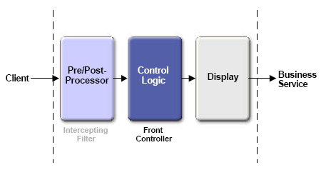

Slide 30
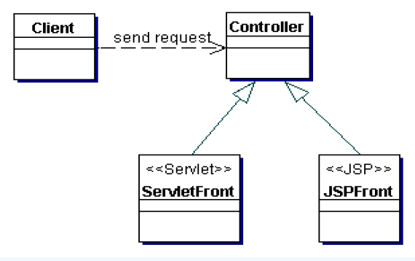
Classes : Front Controller

Slide 31
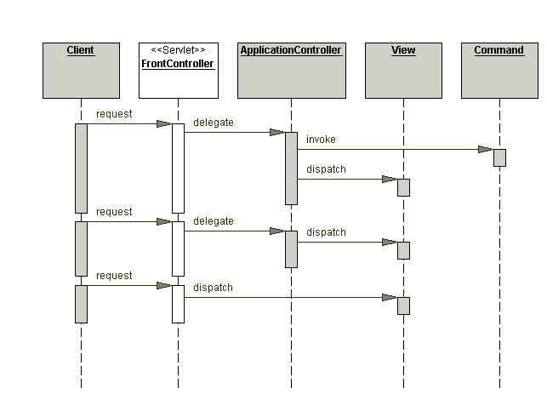
Sequence : Front Controller

Slide 32
Front Controller
View sends request to Controller
Controller processes request and manipulates the Model
Controller dispatches View
View displays Model

Slide 33
<?xml version="1.0" encoding="UTF-8"?>
<web-app xmlns="http://java.sun.com/xml/ns/j2ee" xmlns:xsi="http://www.w3.org/2001/XMLSchema-instance" version="2.4" xsi:schemaLocation="http://java.sun.com/xml/ns/j2ee http://java.sun.com/xml/ns/j2ee/web-app_2_4.xsd">
<servlet>
<servlet-name>action</servlet-name>
<servlet-class>org.apache.struts.action.ActionServlet</servlet-class>
<init-param>
<param-name>config</param-name>
<param-value>/WEB-INF/struts-config.xml</param-value>
</init-param>
<init-param>
<param-name>debug</param-name>
<param-value>3</param-value>
</init-param>
<init-param>
<param-name>detail</param-name>
<param-value>3</param-value>
</init-param>
<load-on-startup>0</load-on-startup>
</servlet>
<servlet-mapping>
<servlet-name>action</servlet-name>
<url-pattern>*.do</url-pattern>
</servlet-mapping>
<welcome-file-list>
<welcome-file>index.jsp</welcome-file>
</welcome-file-list>
</web-app>
ActionServlet is the Front Controller in Struts 1.2

Slide 34
<?xml version="1.0" encoding="UTF-8"?>
<web-app version="2.4"
xmlns="http://java.sun.com/xml/ns/j2ee"
xmlns:xsi="http://www.w3.org/2001/XMLSchema-instance"
xsi:schemaLocation="http://java.sun.com/xml/ns/j2ee http://java.sun.com/xml/ns/j2ee/web-app_2_4.xsd">
<display-name>Struts 2 Application</display-name>
<filter>
<filter-name>struts2</filter-name>
<filter-class>
org.apache.struts2.dispatcher.FilterDispatcher
</filter-class>
</filter>
<filter-mapping>
<filter-name>struts2</filter-name>
<url-pattern>/*</url-pattern>
</filter-mapping>
<welcome-file-list>
<welcome-file>index.jsp</welcome-file>
</welcome-file-list>
</web-app>
FilterDispatcher is the Interceptor in Struts 2.0

Slide 35

Multi tasking Front controller
Can result in a bloated controller servlet
Have a controller for each area of a system
So, We use the Command and Controller strategy
Notes:
Bloated- overlarge, exccesive
Synonyms: 1. swell, inflate, enlarge, balloona

Slide 36
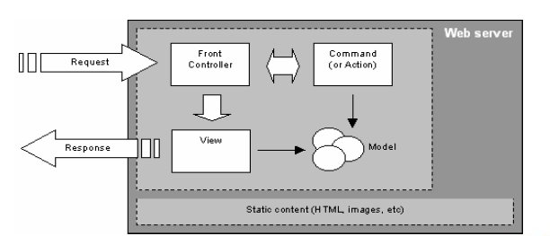
Solution : Command Strategy
Notes:
Servlet Front Strategy- This strategy suggests implementing the controller as a servlet. Though semantically equivalent, it is preferred to the JSP Front Strategy.
JSP Front Strategy
This strategy suggests implementing the controller as a JSP page. Though semantically equivalent, the Servlet Front Strategy is preferred to the JSP Front Strategy. Since the controller handles processing that is not specifically related to display formatting, it is a mismatch to implement this component as a JSP page.
Command and Controller Strategy
Based on the Command pattern [GoF], the Command and Controller Strategy suggests providing a generic interface to the helper components to which the controller may delegate responsibility, minimizing the coupling among these components (see "View Helper" on page 33 for more information on helper components). Adding to or changing the work that needs to be completed by these helpers does not require any changes to the interface between the controller and the helpers, but rather to the type and/or content of the commands. This provides a flexible and easily extensible mechanism for developers to add request handling behaviors.
Finally, because the command processing is not coupled to the command invocation, the command processing mechanism may be reused with various types of clients, not just with Web browsers. This strategy also facilitates the creation of composite commands
-----------
Physical Resource Mapping Strategy
»Logical Resource Mapping Strategy
»Dispatcher in Controller Strategy
»Base Front Strategy
»Filter Controller Strategy

Slide 37
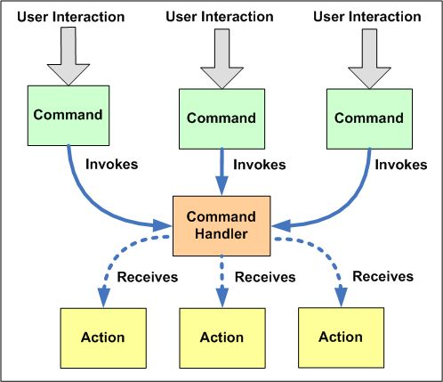
Divide and Share

Slide 38
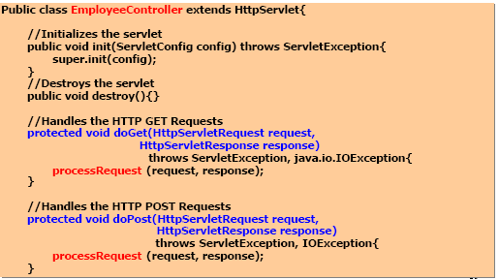
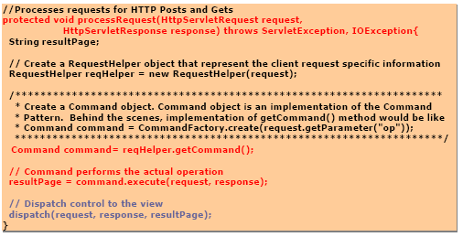
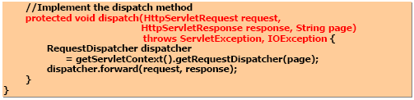

Slide 39
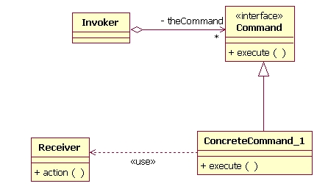
Command and strategy

Slide 40
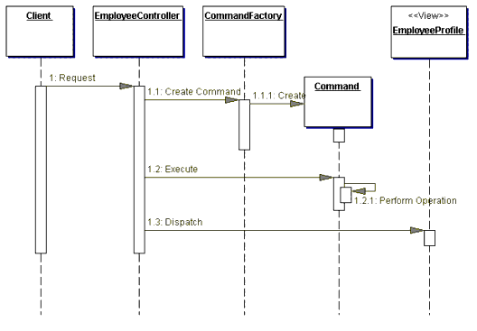
Solution: Command Stratergy

Slide 41
Command Strategy
Logic to handle individual requests moved out of the Front Controller Servlet.
Placed in separate lightweight components
Each component represents a specific command or action
Encapsulates the logic to perform the action

Slide 42
Command Strategy
Handling of requests delegated to actions by the Front Controller
Front Controller Servlet no longer bloated
Controller is simply a action and view dispatcher
Controller receives request from View
Controller passes on request to Action
Action modifies state of the Model
Controller dispatches to View
View renders Model
Externalize mapping of requests to actions
Pass a parameter with the request
Controller maps this to a concrete action at request time

Slide 43


View Helper
View Helper encapsulates logic that is not related to presentation formatting into Helper components
Notes:
Context: The system creates presentation content, which requires processing of dynamic business data.
------------------------------------------
Problem: Presentation tier changes occur often and are difficult to develop and maintain when business data access logic and presentation formatting logic are interwoven. This makes the system less flexible, less reusable, and generally less resilient to change.
»Intermingling the business and systems logic with the view processing reduces modularity and also provides a poor separation of roles among Web production and software development teams.
---------------------------------------
Forces:
•Business data assimilation requirements are nontrivial.
•Embedding business logic in the view promotes a copy-and-paste type of reuse.
This causes maintenance problems and bugs, because a piece of logic is reused in the same or different view by simply duplicating it in the new location.
Solution:
A view contains formatting code, delegating its processing responsibilities to its helper classes, implemented as JavaBeans or custom tags.
Helpers also store the view's intermediate data model and serve as business data adapters.
-------------------------
Implementation Strategies:
»JSP View Strategy
»Servlet View Strategy
»Java Bean Helper Strategy
»Custom Tag Helper Strategy
»Business Delegate as Helper Strategy
»Transformer Helper Strategy
--------------------------------------

Slide 44
Context: The system creates presentation content, which requires processing of dynamic business data.
Problem: Presentation tier changes occur often and are difficult to develop and maintain when business data access logic and presentation formatting logic are interwoven. This makes the system less flexible, less reusable, and generally less resilient to change.
»Intermingling the business and systems logic with the view processing reduces modularity and also provides a poor separation of roles among Web production and software development teams.

Slide 45
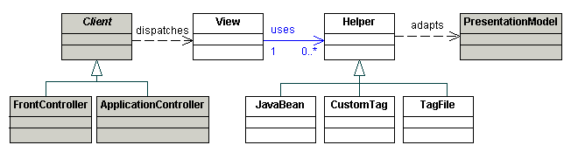
Classes : View Helper
Notes:
Discuss about custom tags and java beans
===============================

Slide 46
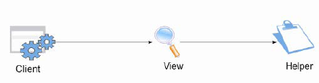
View Helper
Reduce the amount of presentation logic coded directly into the view
Retrieval of data to display (e.g. from the model)
Presentation logic (e.g. hiding information)
General logic (e.g. iterating, etc)
JavaBeans & Custom Tags

Slide 47
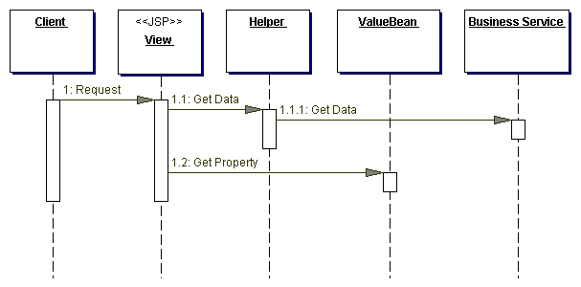
Sequence : View Helper

Slide 48
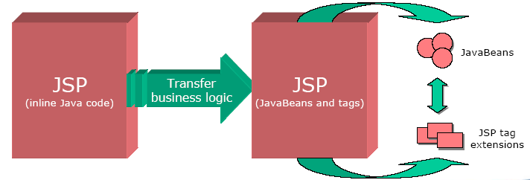
View Helper
•To Adopt the View Helper pattern..
Implement logic as JavaBeans or, preferably, as JSP standard actions or custom tags
Provides separation between content and presentation of that content
Can provide a more natural interface to the page author
Eliminates a “copy and paste” style of reuse

Slide 49
View Helper
Typical JSP Code
Custom tags Approach
<%
String s;
Iterator it = myCollection.iterator();
while (it.hasNext())
{
s = (String)it.next();
%>
some body to be iterated over
<%
}
%>
<iterate id=“s” type=“java.lang.String”
collection=“<%=myCollection%>”/>
some body to be iterated over
</iterate>

Slide 50


Dispatcher View
Dispatcher View combines a dispatcher component with the Front Controller and View Helper Patterns, deferring many activities to View processing.
Notes:
Globalforward in Struts:- Dispather view
Context: System controls flow of execution and access to presentation processing, which is responsible for generating dynamic content.
-------------
Problem: The problem is a combination of the problems solved by the Front Controller and View Helper patterns in the presentation tier. There is no centralized component for managing access control, content retrieval or view management, and there is duplicate control code scattered throughout various views. Additionally, business logic and presentation formatting logic are intermingled within these views, making the system less flexible, less reusable, and generally less resilient to change.
-----------------------
Forces:
•Authentication and authorization checks are completed per request.
•Scriptlet code within views should be minimized.
•Business logic should be encapsulated in components other than the view.
•Control flow is relatively simple and is typically based on values encapsulated with the request.
•View management logic is limited in complexity.
----------------------------
Solution:
Use Dispatcher View with views as the initial access point for a request. Business processing in limited form is managed by the views. Use this approach when response generation requires little or no dynamic content, through a business service or data access call.
•The response is entirely static that is, a static HTML page.•The response is dynamic generated from the presentation model.
Use “Service to Worker” if there is a large dynamic component to the response and the presentation model must be retrieved via business service invocations.
------------------------
Implementation Strategies :
»JSP Front Strategy
»Servlet Front Strategy
»JSP View Strategy
»Servlet View Strategy
»Java Bean Helper Strategy
»Custom Tag Helper Strategy
»Dispatcher in View Strategy
»Dispatcher in Controller Strategy
»Transformer Helper Strategy

Slide 51
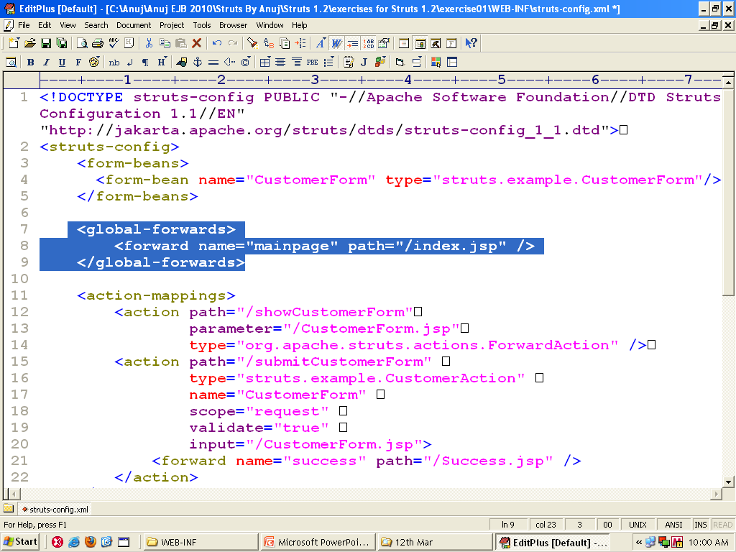

Slide 52
Dispatcher View
You want a view to handle a request and generate a response, while managing limited amounts of business processing.
In certain use cases, there is little or no business processing performed before rendering the view.
This is the case when the view is static or is generated from an existing presentation model. The view requests limited business or data access services.
Use this approach when response generation requires little or no dynamic content, via a business service or data access call.
Strategies are as same as “Service to worker”.
Notes:
Discuss about RequestDispatcher

Slide 53
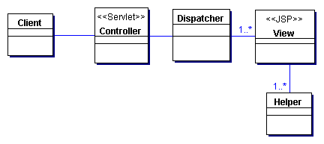
Classes : Dispatcher View

Slide 54
Forces
You have static views.
You have views generated from an existing presentation model.
You have views which are independent of any business service response.
You have limited business processing.

Slide 55
Strategies
Servlet Front Strategy
JSP Front Strategy
Template-Based View Strategy
Controller-Based View Strategy
JavaBean Helper Strategy
Custom Tag Helper Strategy
Dispatcher in Controller Strategy

Slide 56
Servlet Front Strategy: A servlet determines workflow using the request, which the servlet then forwards to the appropriate view.
JSP Front Strategy: A JSP determines workflow, then forwards the request to the view.
JSP View Strategy: A combination of the JSP Front and the presentation logic. The JSP determines which view to use based on the request; this can be achieved with something as simple as an if statement.
Servlet View Strategy: Similar to the JSP View Strategy, except it employs servlets.
JavaBean Helper Strategy: A JavaBean dispatches to the view based on the request.
Custom Tag Helper Strategy: A tag library dispatches from a JSP.
Dispatcher in Controller Strategy: The Controller performs the dispatching.

Slide 57
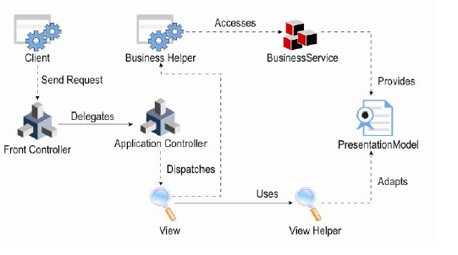
Dispatcher View

Slide 58
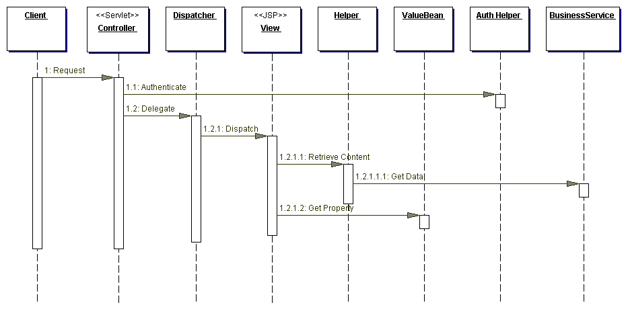
Classes : Dispatcher View

Slide 59
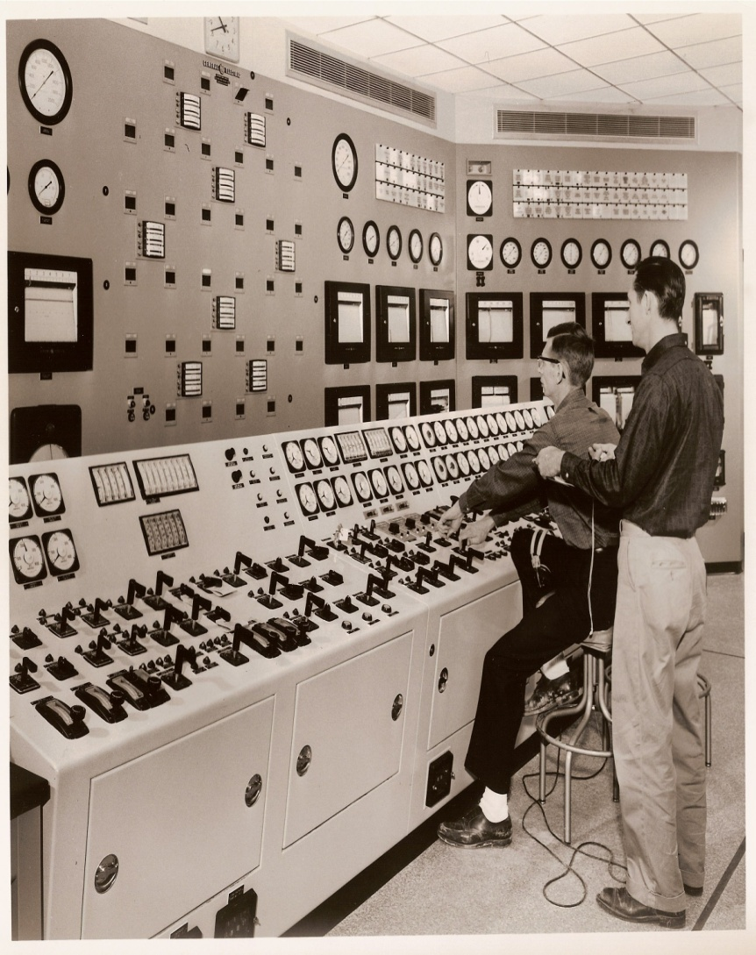
Application Controller
Application Controller centralize, modularize action, and view management
Notes:
Eg. Demonstrate about struts-config.xml in this pattern
Context: You can encapsulate action management and view management in different parts of the application.
Embedding this behavior within a Front Controller centralizes the functionality.
-----------------
Problem: In the presentation tier, there are typically two decisions to be made upon the arrival of each request:
•The incoming request must be resolved to an action that services the request. This is called action management.
•The appropriate view is located and dispatched. This is called view management.
-------------------------
Forces:
•You want to reuse action and view-management code.
•You want to improve request-handling extensibility, such as adding use case functionality to an application incrementally.
•You want to improve code modularity and maintainability, making it easier to extend the application and easier to test discrete parts of your request-handling code independent of a web container.
-------------------------
Solution:
Uses an Application Controller to centralize retrieval and invocation of request-processing components, such as commands and views. Action management refers to locating and invoking actions to handle specific requests, while view management refers to navigating and dispatching to the appropriate view or view-generation mechanism.
-------------------------------
Implementation Strategies:
»Command Handler Strategy
»View Handler Strategy
»Transform Handler Strategy
»Navigation and Flow Control Strategy
------------------------------------------------
Participants and Responsibilities
Client
It invokes the Application Controller. In the presentation tier, a FrontController or an InterceptingFilter typically fulfill this role.
ApplicationController
Uses Mapper to resolve an incoming request to the appropriate action and view, to which it delegates or dispatches.
Mapper
Mapper uses a Map to translate an incoming request into the appropriate action and view. A Mapper acts as a factory.
Map
Map holds references to handles that represent target resources. Maps might be realized as a class or a registry.
Target
A resource that helps fulfill a particular request, including commands, views, and style sheets.

Slide 60
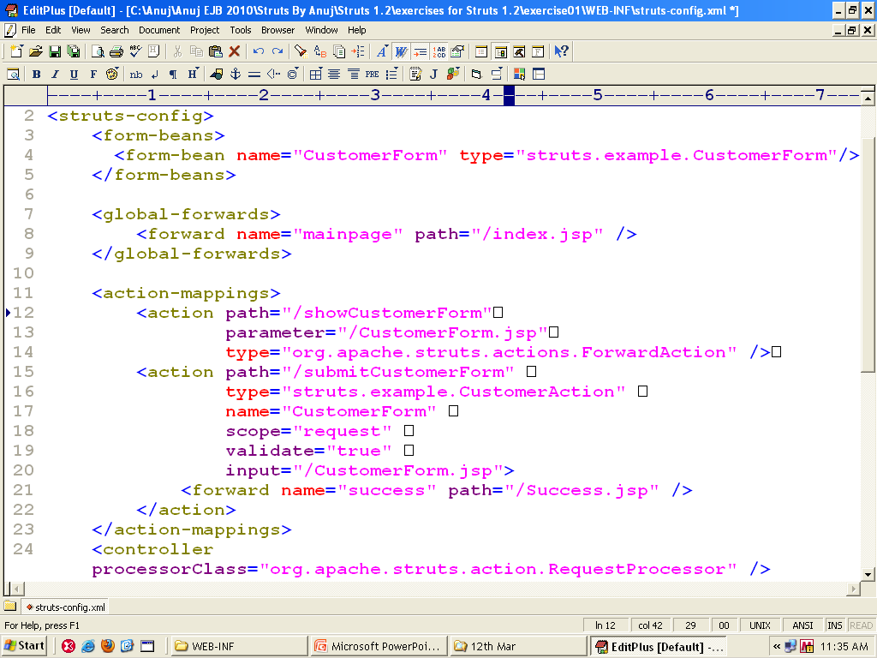

Slide 61
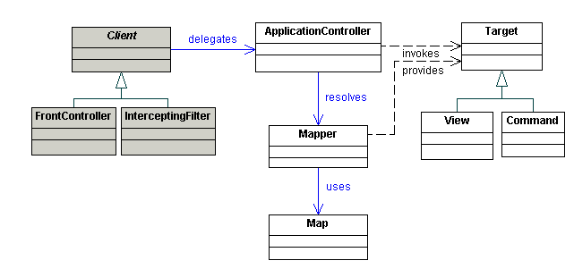
Classes : Application Controller
Notes:
Demonstrate about struts-config.xml in this pattern
-------
The struts-config.xml file from the example application includes the following mapping entry for the "log on" function, which we will use to illustrate the requirements. Note that the entries for all the other actions are left out:
<struts-config>
<form-beans>
<form-bean
name="logonForm"
type="org.apache.struts.example.LogonForm" />
</form-beans>
<global-forwards
type="org.apache.struts.action.ActionForward" />
<forward name="logon" path="/logon.jsp"
redirect="false" />
</global-forwards>
<action-mappings>
<action
path="/logon"
type="org.apache.struts.example.LogonAction"
name="logonForm"
scope="request"
input="/logon.jsp"
unknown="false"
validate="true" />
</action-mappings>
</struts-config>
-------------------
Optional but very useful are the local "forward" elements. In the example application, many actions include a local "success" and/or "failure" forward as part of an Action mapping.
<!-- Edit mail subscription -->
<action path="/editSubscription"
type="org.apache.struts.example.EditSubscriptionAction"
name="subscriptionForm"
scope="request"
validate="false">
<forward name="failure" path="/mainMenu.jsp"/>
<forward name="success" path="/subscription.jsp"/>
</action>
-----------------------------------

Slide 62
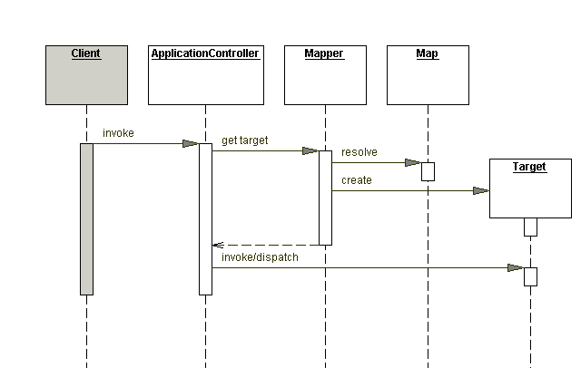
Sequence : Application Controller

Slide 63
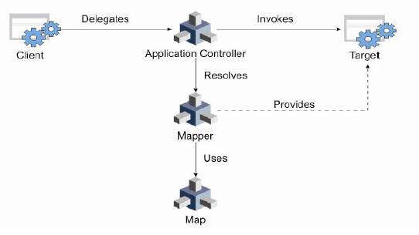
Application Controller

Slide 64
The struts-config.xml file from the example application includes the following mapping entry for the "log on" function, which we will use to illustrate the requirements. Note that the entries for all the other actions are left out:
<struts-config>
<form-beans>
<form-bean
name="logonForm"
type="org.apache.struts.example.LogonForm" />
</form-beans>
<global-forwards
type="org.apache.struts.action.ActionForward" />
<forward name="logon" path="/logon.jsp"
redirect="false" />
</global-forwards>
<action-mappings>
<action
path="/logon"
type="org.apache.struts.example.LogonAction"
name="logonForm"
scope="request"
input="/logon.jsp"
unknown="false"
validate="true" />
</action-mappings>
</struts-config>
-------------------
Optional but very useful are the local "forward" elements. In the example application, many actions include a local "success" and/or "failure" forward as part of an Action mapping.
<!-- Edit mail subscription -->
<action path="/editSubscription"
type="org.apache.struts.example.EditSubscriptionAction"
name="subscriptionForm"
scope="request"
validate="false">
<forward name="failure" path="/mainMenu.jsp"/>
<forward name="success" path="/subscription.jsp"/>
</action>

Slide 65
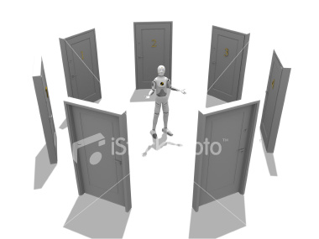
Service to worker
You want to perform core request handling and invoke business logic before control is passed to the view.
Notes:
Demonstrate : action forward in struts…..
Context:
Business and the data services are invoked before the view is rendered. For any particular request, then by seeing problems which can occur. we have to see how much work needs to be done during the view preparation phase of request processing.
---------------------
Problem:
•How sophisticated is the control logic?
•How dynamic is the response content?
•How sophisticated is the business logic and model?
------------------------------
Forces:
•You want specific business logic executed to service a request in order to retrieve content that will be used to generate a dynamic response.
•You have view selections which may depend on responses from business service invocations.
•You may have to use a framework or library in the application.»
--------------------
Solution:
Use Service to Worker to centralize control and request handling to retrieve a presentation model before turning control over to the view. The view generates a dynamic response based on the presentation model.
Service to Worker is composed of several other patterns. Centralized control, request handling, and view creation are accomplished using Front Controller, Application Controller, and View Helper respectively.
------------------------
Implementation Strategies:
»JSP Front Strategy
»Servlet Front Strategy
»JSP View Strategy
»Servlet View Strategy
»Java Bean Helper Strategy
»Custom Tag Helper Strategy
»Transformer Helper Strategy

Slide 66
Service to worker
In certain use cases, business and the data services are invoked before the view is rendered.
Forces
You want specific business logic executed to service a request in order to retrieve content that will be used to generate a dynamic response.
You have view selections which may depend on responses from business service invocations.
You may have to use a framework or library in the application.
Ex-http://some.server.com/Controller?action=login
Notes:
Talk about data source tag
Which contains url and drivers

Slide 67
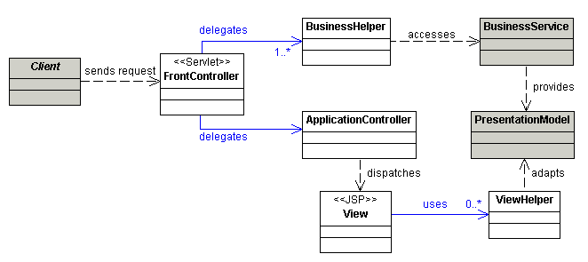
Classes : Service to worker
Notes:
• Client
– Object requesting the generation of the view
• Controller
– Initial point of contact for handling a request
• Dispatcher
– Responsible for view management and navigation
– Manages the choice of the next view to be presented to the user
– Can be encapsulated within the controller
• View
– Represents and displays information to the client

Slide 68
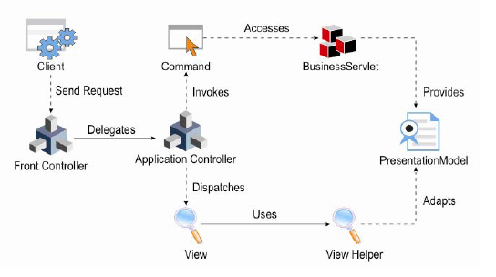
Service to worker

Slide 69
This is how you would specify a basic data source for your application inside of struts-config.xml:
<struts-config>
<data-sources>
<data-source
autoCommit="false"
description="Example Data Source Description"
driverClass="org.postgresql.Driver"
maxCount="4"
minCount="2"
password="mypassword"
url="jdbc:postgresql://localhost/mydatabase"
user="myusername"/>
</data-sources>
</struts-config>

Slide 70
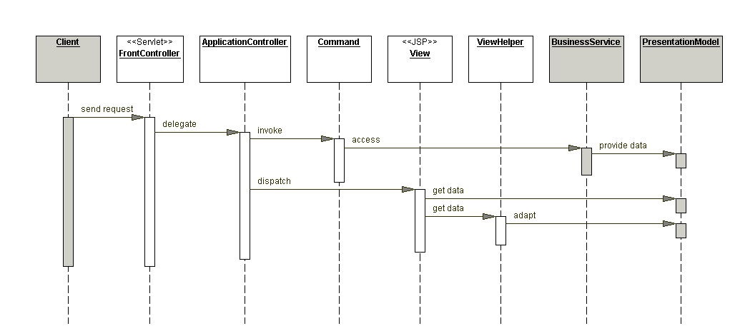
Sequence : Service to worker

Slide 71
Service to worker
Combine the Front Controller and View Helper patterns to move some presentation logic
forward into the controller and application logic back into Helpers.
A Front Controller is the initial point of contact for the request and is responsible for
Managing many aspects of request handling
System services such as authentication and authorization
Delegation of business processing, choosing an appropriate view, selection of content-creation strategies.
Preparing the model for use by the view , which it dispatches
Notes:
• Helper
– Responsible for helping a view or controller complete its processing
– Also responsible for gathering data required by the view and storing this intermediate model.
• ValueBean
– Another name for the helper
– Responsible for holding intermediate model state for use by a view
• Business Service
– Role that is fulfilled by the service the client is seeking to access.
– Accessed via a business delegate

Slide 72
Strategies
Following are the strategies relevant to Service to Worker.
Servlet Front Strategy
JSP Front Strategy
Template-Based View Strategy
Controller-Based View Strategy
JavaBean Helper Strategy
Custom Tag Helper Strategy
Dispatcher in Controller Strategy

Slide 73
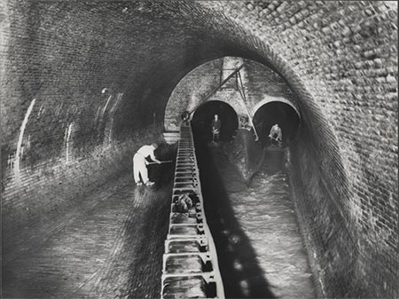
Intercepting Filter
Intercepting Filter facilitates pre-processing and post-processing of a request:
Notes:
Context: The presentation-tier request handling mechanism receives many different requests, which must be modified, audited, or uncompressed before being further processed.
Problem: Pre-processing and post-processing of a client Web request and response are required to be done. When a request enters a Web application, it often must pass several entrance tests prior to the main processing stage for that various components are added. The key to solving this problem is creating mechanism for adding and removing processing components, in which each component completes a specific action.
------------------
Forces:
Processing such as checking the data-encoding scheme or logging information about each request, completes per request. Services should be easy to add or remove unobtrusively without affecting existing components, so that they can be used in a variety of combinations, such as:
•Logging and authentication
•Debugging and transformation of output for a specific client
•Uncompressing and converting encoding scheme of input
Solution:
These problems are solved by processing with a variety of common services, such as security, logging, debugging, and so forth. These filters are components that are independent of the main application code and they may be added or removed declaratively.
------------------------------------
Implementation Strategies:
»Custom Filter Strategy
»Standard Filter Strategy
»Base Filter Strategy
»Template Filter Strategy
-----------------------------------------
Standard Filter Strategy:
This is commonly used implementation strategy. Filters are controlled declaratively using a deployment descriptor includes a standard mechanism for building filter chains and unobtrusively adding and removing filters from those chains. Filters are built around interfaces, and added or removed in a declarative manner by modifying the deployment descriptor for a Web application.
-----------------------------------------------

Slide 74
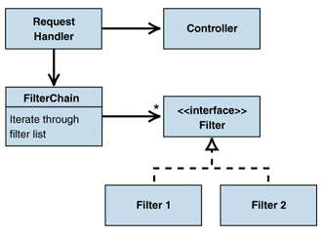
Intercepting Filter
Notes:
Discuss about gmail
Which reject when we try to upload any exe file.
So, it is coded at inceterper level...

Slide 75
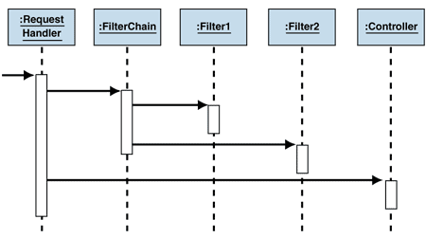
Sequence : Intercepting Filter

Slide 76
Interceptor Pattern can be Use for
Authentication
Access Validation
System Logging
System Debugging
Data Encoding
Browser Trapping
Response Filtering
Notes:
Any use that you can think of…

Slide 77
javax.servlet.Filter
void init(FilterConfig filterConfig)
void doFilter(ServletRequest request, ServletResponse response, FilterChain chain)
void destroy()
Notes:
These are the three methods of the interface. The doFilter() method must call chain.doFilter() to pass the request along to the next filter or to end the process. If it doesn’t, it must setup the response.

Slide 78
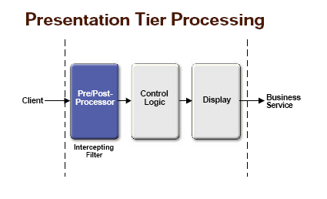
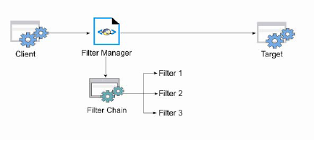
javax.servlet.FilterChain
void doFilter(ServletRequest request, ServletResponse response)
Notes:
This is the required call for filters that are ready for the next filter in the chain to be invoked.

Slide 79
javax.servlet.http Wrappers
javax.servlet.http.HttpServletRequestWrapper
javax.servlet.http.HttpServletResponseWrapper
These classes provide a complete set of methods implementing the HttpServletRequest and HttpServletResponse classes.
Notes:
These provide default implementations of the request and response methods, delegating to the originals by default. These allow filters to change the way the requests and responses will be handled.

Slide 80
An Example of Filter
public class EncodingFilter implements Filter {
private FilterConfig config = null;
// default to ASCII
private String targetEncoding = "ASCII";
public void init(FilterConfig config) throws ServletException {
this.config = config;
this.targetEncoding = config.getInitParameter("encoding");
}
public void destroy() {
config = null;
targetEncoding = null;
}
public void doFilter(ServletRequest srequest, ServletResponse sresponse, FilterChain chain)
throws IOException, ServletException {
HttpServletRequest request = (HttpServletRequest)srequest;
request.setCharacterEncoding(targetEncoding);
// move on to the next
chain.doFilter(srequest,sresponse);
}
}

Slide 81
Deployment Descriptor web.xml
New tags filter and filter-mapping
<filter>
<filter-name>EncodeFilter</filter-name>
<display-name>EncodeFilter</display-name>
<description></description>
<filter-class>encodefilter.EncodeFilter</filter-class>
</filter>
<filter-mapping>
<filter-name>EncodingFilter</filter-name>
<url-pattern>/*</url-pattern>
</filter-mapping>
Notes:
These follow the same pattern as servlet and servlet-mapping. The filter must be named and then mapped to a URL pattern. The pattern here matches all requests under the context root.

Slide 82

Composite View
Composite View creates an aggregate View from atomic sub-components.
Notes:
Eg. <jsp:include>
Context: Sophisticated Web pages present content from numerous data sources, using multiple subviews that comprise a single display page.
---------------------------
Problem: Instead of providing a mechanism to combine modular, atomic portions of a view into a composite whole, pages are built by embedding formatting code directly within each view.
------------------------------
Forces:
•Atomic portions of view content change frequently.
•Multiple composite views use similar sub views, such as a customer inventory table. These atomic portions are decorated with different surrounding template text, or they appear in a different location within the page.
•Layout changes are more difficult to manage and code harder to maintain when subviews are directly embedded and duplicated in multiple views.
Solution:
Using composite views that are composed of multiple atomic subviews. Each component of the template may be included dynamically into the whole and the layout of the page may be managed independently of the content.
It promotes the reuse of atomic portions of the view by encouraging modular design.
---------------------------
Implementation Strategies:
»JSP View Strategy
»Servlet View Strategy
»Java Bean View Management Strategy
»Standard Tag View Management Strategy
»Custom Tag View Management Strategy
»Transformer View Management Strategy
»Early Binding Resource Strategy
»Late Binding Resource Strategy
----------------------------

Slide 83
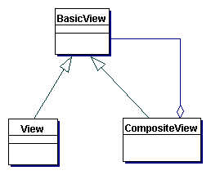
Composite view
Notes:
Talk about view which contain multiple pages..... And form a single page by using several jsp pages

Slide 84

Composite view
Multiple JSP pages form a composite view

Slide 85

Composite view

Slide 86

Sequence :Composite View

Slide 87

Composite View
When presentation tier components interact directly with the business services components like EJB,
the presentation components are difficult to changes in the implementation of business services components
Notes:
Vulnerable- open to assault; difficult to defend:

Slide 88

Context Object
Context Object avoid using protocol specific system information outside of its relevant context
encapsulates state in a protocol-independent way to be shared throughout your application. Using Context Object makes testing easier, facilitating a more generic test environment with reduced dependence upon a specific container. The Context Object pattern is used to encapsulate the specifics of protocol implementation to be shared. .
Notes:
Context: An application typically uses system information, such as request, configuration, and security data, throughout the lifecycle of a request and response. Aspects of this system information are accessed based on their relevance to a certain processing context.
--------------
Problem: When application-specific components and services are exposed to system information that is outside their context, flexibility and reusability of these components are reduced.
Each client component is then tightly coupled with that specific protocol.
-------------------
Participants and Responsibilities
Client
It creates an object with ProtocolInterface.
ProtocolInterface
It is an object that exposes protocol or tier-specific details.
ContextFactory
A ContextFactory creates a protocol- and tier-independent ContextObject.
ContextObject
ContextObject is a generic object used to share domain-neutral state throughout an application.
--------------------------
Forces:
•You have components and services that need access to system information.
•You want to decouple application components and services from the protocol specifics of system information.
•You want to expose only the relevant APIs within a context.
------------------
Solution:
Use a Context Object to encapsulate state in a protocol -independent way to be shared throughout your application.
Encapsulating system data in a Context Object allows it to be shared with other parts of the application without coupling the application to a specific protocol.
-----------------------
Implementation Strategies:
»Configuration Context Strategies
»Request Context Strategies
»Security Context Strategies
»General Context Strategies
»Context Object factory Strategy
------------------------------------

Slide 89
Problem:
When application-specific components and services are exposed to system information that is outside their context, flexibility and reusability of these components are reduced.
Each client component is then tightly coupled with that specific protocol.
Participants and Responsibilities
Client
It creates an object with ProtocolInterface.
ProtocolInterface
It is an object that exposes protocol or tier-specific details.
ContextFactory
A ContextFactory creates a protocol- and tier-independent ContextObject.
ContextObject
ContextObject is a generic object used to share domain-neutral state throughout an application.

Slide 90
Solution:
Use a Context Object to encapsulate state in a protocol -independent way to be shared throughout your application.
Encapsulating system data in a Context Object allows it to be shared with other parts of the application without coupling the application to a specific protocol.

Slide 91
End of Presentation Design Pattern

Slide 92

Business And Integration Layer

Slide 95
Business Delegate
Business Delegate decouples presentation and service tiers, and provides a facade and proxy interface to the services.
Plain Java classes that hide EJB API complexity by encapsulating code required to discover, delegate to and recover from invocations on the session and message facade EJB layers.
Use on large projects where the web team is separate from the EJB team .

Slide 96


Business Delegate
Business Delegate decouples presentation and service tiers, and provides a facade and proxy interface to the services.
Plain Java classes that hide EJB API complexity by encapsulating code required to discover, delegate to and recover from invocations on the session and message facade EJB layers.
Use on large projects where the web team is separate from the EJB team
Notes:
Context: The business delegate pattern provides solutions to recurring problems. The common problems while developing J2EE applications and how these problems are solved using patterns are detailed here.
---------------------
Problem:
The client classes using a remote API will change when the API interfaces change.
Clients interact directly with the business service interface. This means that when the business service code changes, the client code might need to be changed.
------------------------
Forces:
•You want to access the business-tier components from your presentation-tier components and clients, such as devices, web services, and rich clients.
•You want to minimize coupling between clients and the business services, thus hiding the underlying implementation details of the service, such as lookup and access.
•You want to avoid unnecessary invocation of remote services.
•You want to translate network exceptions into application or user exceptions
-----------------
Solution: Use a Business Delegate to encapsulate access to a business service. The Business Delegate hides the implementation details of the business service, such as lookup and access mechanisms.
»The intermediate business delegate class separates the business components from the classes that use them.
»Advantages:
•The logic to look up the remote API can be isolated.
•The client class is isolated from changes in EJB classes.
--------------------------------------
Implementation Strategies:
»Delegate Proxy Strategy
»Delegate Adapter Strategy
Delegate Proxy strategy: A business delegate acts as a proxy for a remote business service, passing client method calls to the service object for which it is acting as a proxy. While you implement this delegate proxy as a business-tier developer, you can add behavior such as some types of validation and caching business data and references. Caching can include the remote references to a session bean's home or remote objects to improve performance by reducing the number of lookups.

Slide 97

Business Delegate
Typically, Web Client directly acessing a business object, Such as EJB needs to implement the client-side API of the Business Object.
The Web Client also needs to perform the necessary lookup to locate the business object to access them.
As a result, Any changes in the implementation of the business object results in the change of all the web clients that accesses it.
The business delegate design pattern provides a solution to this problem by introducing business delegate object. The business delegate object encapsulates the logic to access business object from the web client.
The Web Client remains transparent of how the business object is implemented and only interacts locally with the business delegate object.
Notes:
Business Delegate Design pattern
====================
The Business Delegate design pattern hides the complexity of calling remote business methods of EJB components by Web Clients.
Typically, Web Client directly acessing a business object, Such as EJB needs to implement the client-side API of the
Business Object.
The Web Client also needs to perform the necessary lookup to locate the business object to access them.
As a result, Any changes in the implementation of the business object results in the change of all the web clients that accesses it.
The business delegate design pattern provides a solution to this problem by introducinga business delegate object. The business delegate object encapsulates the logic to access business object from the web client.
The Web Client remains transparent of how the business object is implemented and only interacts locally with the business delegate object.

Slide 98

Service Locator
Service Locator encapsulates the complexity of business service lookup and creation. It locates business service factories.
Service lookup and creation involves complex interfaces and network operations.
EJB clients need to use the JNDI API to look up EJBHome objects
JMS clients need to use JNDI API to look up JMS components
context factory to use for the initial JNDI context creation is vendor dependent Initial context
Notes:
Context: You want to transparently locate business components and services in a uniform manner.
Problem: J2EE applications clients need to locate and access business-tier components and services.
For that it must first look up specific object and then obtain the connection or session from the factory.
When you implement a lookup mechanism in your clients, you can deal with several problems related to complexity, duplication of code, performance degradation, and vendor dependency.
--------------------------
Forces:
•You want to use the JNDI API to look up and use business components, such as enterprise beans and JMS components, and services such as data sources.
•You want to centralize and reuse the implementation of lookup mechanisms for J2EE application clients.
•You want to encapsulate vendor dependencies for registry implementations, and hide the dependency and complexity from the clients.
-------------------
Solution:
•A Service Locator is used to implement and encapsulate service and component lookup. A Service Locator hides the implementation details of the lookup mechanism and encapsulates related dependencies.
•Application clients can reuse the Service Locator to reduce code complexity, provide a single point of control, and improve performance by providing a caching facility.
•A Service Locator reduces the client's dependency on the underlying lookup infrastructure, and optimizes resource-intensive lookup and creation operations.
-------------------------
Implementation Strategies:
»EJB Service Locator Strategy
»JMS Queue/Topic Locator Strategy
»JDBC Data Source Locator Strategy
»Web Service Locator Strategy
Depending on the service objects being cached you have different implementations.

Slide 99

Service Locator

Slide 100

Service Locator

Slide 101
Service Locator
Use a Service Locator object to abstract all JNDI usage and to hide the complexities of initial context creation, EJB home object lookup, and EJB object re-creation.
Multiple clients can reuse the Service Locator object to reduce code complexity.
provide a single point of control.
Service Locator can improve performance by providing a caching facility.

Slide 102

Service Locator

Slide 103

Session Façade
Session Façade hides business object complexity and centralizes workflow handling.
In multi-tiered application, business logic is encapsulated in server-side components.
Business component expose interfaces and hide complexity to client.
Notes:
Context: You want to expose business components and services to remote clients.
• Controls client access to business objects.
• Limits the network traffic between remote clients and fine-grained business components and services.
--------------
Problem:
•Tight coupling between the client and the business components leads to direct dependency.
•Direct access require the client to have complex logic to coordinate and interact with many business components, thus the client must have the complex logic to do lookups, demarcate transactions, manage security, and do business processing. This increases the complexity and responsibility of the client.
•When you have different types of clients, direct access to business components leads to inconsistent use of the common business components.
-----------------------------
Forces:
•You want to avoid giving clients direct access to business-tier components, to prevent tight coupling with the clients.
•You want to provide a remote access layer to your Business Objects and other business-tier components.
•You want to aggregate and expose your Application Services and other services to remote clients.
•You want to centralize and aggregate all business logic that needs to be exposed to remote clients
----------------------
Solution:
Use a Session Façade to encapsulate business-tier components and expose a coarse-grained service to remote clients.
Clients access a Session Façade instead of accessing business components directly.
-----------------------------------------------
Implementation Strategies:
»Stateful Session Façade Strategy:
A business process that needs only one method call to complete the service is a non-conversational business process. Such processes are suitably implemented using a stateless session bean.
»Stateless Session Façade Strategy:
A business process that needs multiple method calls to complete the service is a conversational business process. The conversational state must be saved between each client method invocation. In this scenario, a stateful session bean might be a more suitable approach for implementing the Session Façade.
------------------------------------

Slide 104

Session Facade
Notes:
the front of a building,
esp. an imposing or decorative one.
b. any side of a building facing a public way or space and finished accordingly.

Slide 105

Session Facade

Slide 106


Session Facade

Slide 107
Session Facade
Client calls interfaces provided by Business Objects directly and this leads to tight coupling, which leads to direct dependence between clients and business objects;
Too many method invocations between client and server, leading to network performance problems;
Provide a simpler interface to the clients by hiding all the complex interactions and interdependencies between business components
A unified service layer must be provided for coarse-grained access by all clients, based on use cases.
Business Object is not protected from misuse.

Slide 108
Session Facade
Use a session bean as a facade to encapsulate the complexity of interactions between the business objects in a workflow.
The Session Façade will be responsible for Locating, creating and modifying the business objects Providing a uniform coarse-grained service access.

Slide 109
Session Facade
Use-case approach to defining Session Façade interface
Simpler, uniform interface to the clients
Reduce coupling between clients and business objects
Less network traffic
Coarse-grained abstraction of workflow
Centralize security and transaction management

Slide 110
Fine Grained Entity Bean Design Idiom
The client calls accessor methods on an entity bean to read the value of every individual data member

Slide 111
Coarse Grained Entity Bean Design Idiom
The client uses an entity bean to retrieve a state object populated with database data

Slide 112
Composite Entity
You want to use entity beans to implement your conceptual domain model
problems can arise when using entity beans to implement Business Objects

Slide 113
The first problem is deciding whether to use remote or local entity beans.
Remote entity beans are associated with network overhead and can degrade the performance of the application when not used appropriately.
The second problem is deciding how to implement persistence of your Business Objects as entity beans. You can implement transparent persistence using container-managed persistence and not write your own persistence code

Slide 114
Forces
You want to avoid the drawbacks of remote entity beans, such as network overhead and remote inter-entity bean relationships.
You want to leverage bean-managed persistence (BMP) using custom or legacy persistence implementations.
You want to implement parent-child relationships efficiently when implementing Business Objects as entity beans.
You want to encapsulate and aggregate existing POJO Business Objects with entity beans.
You want to leverage EJB container transaction management and security features.
You want to encapsulate the physical database design from the clients.

Slide 115


Slide 116
Business Object
When there is little or no business logic in a business operation, applications will typically let clients directly access business data in the data store.
For example, a presentation tier component such as a command helper or JSP view, or a business-tier component can directly access a Data In this scenario, there is no notion of an object model in the business tier.
Instead, the application requirements are fulfilled by a procedural implementation. This approach is acceptable for some applications when the data model closely represents the conceptual domain model.

Slide 117


Slide 118
Forces
Components such as bean-managed entity beans, session beans, servlets, and other objects like helpers for JSP pages need to retrieve and store information from persistent stores and other data sources like legacy systems, B2B, LDAP, and so forth.

Slide 119
Solution
Use a Data Access Object (DAO) to abstract and encapsulate all access to the data source. The DAO manages the connection with the data source to obtain and store data.

Slide 120
BusinessObject
The BusinessObject represents the data client. It is the object that requires access to the data source to obtain and store data. A BusinessObject may be implemented as a session bean, entity bean, or some other Java object, in addition to a servlet or helper bean that accesses the data source.
DataAccessObject
The DataAccessObject is the primary object of this pattern. The DataAccessObject abstracts the underlying data access implementation for the BusinessObject to enable transparent access to the data source. The BusinessObject also delegates data load and store operations to the DataAccessObject.

Slide 121

Value List Handler
Value List Handler manages query execution, results caching, and results processing.
Context: You have a remote client that wants to iterate over a large results list.
Notes:
Context: You have a remote client that wants to iterate over a large results list.
Problem: Many J2EE applications have clients that perform various searches. Frequently, these searches are initiated by the presentation tier, executed by the business tier and displayed in the browser. When these searches that result in a large number of matching entity beans, entity bean finder methods are inefficient. Another problem is that clients might not be capable of handling large results, and want the server to manage the results.
------------------

Slide 122
J2EE applications generally have the search facility and have to search huge data and retrieve results. If an application returns huge queried data to the client, the client takes long time to retrieve that large data and If that application uses entity bean to search data, it has an impact on performance largely because EJB by nature has an overhead when compared to normal java object
This process has an impact on performance for two reasons,
1. Application returns large amount of data to the client
2. Entity beans are used to retrieve huge data.
The following figure illustrates this process.

Slide 123

Value List Handler

Slide 124
Forces
You want to avoid the overhead of using EJB finder methods for large searches.
You want to implement a read-only use-case that does not require a transaction.
You want to provide the clients with an efficient search and iterate mechanism over a large results set.
You want to maintain the search results on the server side.

Slide 125
Value List Handler
Use Data Access Objects (DAO) rather than Entity beans
2. Return small quantity of data multiple times iteratively rather than returning large amount of data at once to the client.
Data Access Object encapsulates JDBC access logic. ValueList Handler caches list of Value objects that are retrieved through DAO.
When client wants to search data, It calls ValueList Handler that is in turn responsible for caching data and returning data to the client iteratively.

Slide 126
Session bean and entity bean methods execute synchronously that means the method caller has to wait till a value is returned. In some situations like sending hundred's of mails or firing a batch process or updating processes, the client does not have to bother about return value. If you use synchronous session and entity beans in such situations, they take a long time to process methods and clients have to
wait till the method returns a value.

Slide 127

Data Access Object (DAO)
Data Access Object abstracts data sources provides transparent access to data.
The Data Access Object (DAO) J2EE pattern provides a technique for separating object persistence and data access logic from any particular persistence mechanism or API.
The DAO approach provides flexibility to change an application's persistence mechanism over time without the need to re-engineer application logic that interacts with the DAO tier.

Slide 128

Data Access Objecct
All components of the application can interact with the underlying database through the data access object.
As a result, any change in the underlying database, such as change of the database URL, driver, or even RDBMS does not effect the components handling business logic. Only the data access object needs to be changed.
Notes:
DAO pattern:
========
The Data Access Object Design pattern provide solution to various problems that software developers may come across while accessing external resources fioirnn the j2ee application.
Data Access Object pattern allows encapsulation of the data access logic from the businesss logic of a j2ee application.
Typically, a component of J2EE application that handles the business logic along with the data access logic changes as a result of any change in the underlying data source.
By using Data Access Object pattern, a data access object can be implemented that handles data access logic fro that application.
All components of the application can interact with the underlying database through the data access object.
As a result, any change in the underlying database, such as change of the database URL, driver, or even RDBMS does not effect the components handling business logic. Only the data access object needs to be changed.

Slide 129

Data Access Patterns
The DataAccess Object (DAO) is the primary mechanism for retrieving and manipulating data from the data base.
The Value Object (VO) wraps data retrieved from a relational database in a Java object.

Slide 130
Data Access Object
The Data Access Object consists of an Interface called DataAccessObject.java
The two functions of the DAO Pattern:
Completely abstract away the data source in which the data the user is requesting resides.
Completely abstracts away all of the CRUD (Create, Replace, Update, Delete) logic normally associated with accessing a data source.

Slide 131
Data Access Object
The DAO pattern abstracts away the tasks associated with retrieving and manipulating data by defining a Java interface that has 5 basic methods:
findByPrimaryKey( Object pPrimaryKey )
createValueObject()
insert( ValueObject pValueObject )
update( ValueObject pValueObject )
delete( ValueObject pValueObject )

Slide 132
Data Access Object
Remember, DataAccessObject.java is an interface, so to use it we define one or more member classes that implement the interface:

Slide 133
Pros Reduces network traffic in distributed systems. Transfer objects are passed to the client in a single remote call.
Improves client performance by removing any need to assemble data models.
Decouples business logic from the client and keeps it in the business tier.
Improves transaction performance by isolating the components that can be updated.

Slide 134
Cons Data in transfer objects might get obsolete. The transfer object has a copy of the data which is not automatically updated if the data changes on the server.
The system can be complicated when using concurrent access or transaction management processes.
Synchronization logic can complicate the system if updatable transfer objects are used. Object creation overhead on the server side increases.

Slide 135
Application Service
You want to centralize business logic across several business-tier components and services.
You want to minimize business logic in service facades.
You have business logic acting on multiple Business Objects or services.
You want to provide a coarser-grained service API over existing business-tier components and services.
You want to encapsulate use case-specific logic outside of individual Business Objects

Slide 136


Slide 137
Designing a Framework
DAO’s: Not just about Relational Databases:
MemberDAO
MemberDAO
MemberDAO
MemberDAO
JDBC
JDO
Web Service
XPath
Relational Database
Java Data Object
SOAP envelope
XML
(Xindice)

Slide 138

Value Object
As for Example:
-----------------------
Consider a client that accesses a business object to retrieve and display author information. By implementing the Value Object pattern, the client can obtain all the author information in a single object by making a single method call instead of retrieving the information individually by making a number of method calls.
The client can then locally retrieve all information from the obejct and display it to an end user.
In addition, the business object also needs to expose only a single business method that returns the value object instead of creating multiple business methods for returning different information of the author.
Notes:
The Value Object pattern is a business tier pattern.
This means that the Value Object pattern provides solutions for problems that occur when a client accesses a business object.
A business object is typically implemented as an EJB component that implements the business functionality of the application.
A client can be a JSP or Servlet that accesses the business object.
---------
The Value Object is also known as data transfer object pattern that describes how an object can act as a data container to transfer data between a client and the business object.
The Value Object pattern specifies that instead of obtaining data by making multiple remote method calls to a busines object, logical data can be stored in an object and then transferred over the network, thereby reducing the number of network calls between the client and the business object.
Using Value Objects to transfer data not only minimizes network overhead but also simplifies the coding of the business methods.
-----------------------------
As for Example:
----------------------------
Consider a client that accesses a business object to retrieve and display author information. By implementing the Value Object pattern, the client can obtain all the author information in a single object by making a single method call instead of retrieving the information individually by making a number of method calls.
The client can then locally retrieve all information from the obejct and display it to an end user.
In addition, the business object also needs to expose only a single business method that returns the value object instead of creating multiple business methods for returning different information of the author.

Slide 139
Value Object
The Value Object consists of an abstract class called ValueObject.java
A Value Object Pattern wraps a row of data retrieved from a data source in a Plain Old Java (POJ) class:
This lets the user deal with a logical view of the data instead of a physical view.
Value objects hide the data types of the data being retrieved.
Value objects hide the relationships that exist between tables in the database.
Value objects are the glue that ties the tiers together. They are used to pass data back and forth between all tiers in the application.

Slide 140

Value Object

Slide 141
Value Object
The VO class has 3 status fields with their own get() and set() methods that are used to tell the DAO what to do with the VO:
boolean insertFlag
boolean updateFlag
boolean deleteFlag
At any given time, only 1 of the flags may be true. Setting any one of the flags resets the others to false. The VO class also provides a reset() method that clears all flags to false.
Finally, the VO class provides get() and set() methods for a rowVersion field. long rowVersion is used to implement the framework’s locking strategy.

Slide 142

Value Object
Remember, ValueObject.java is abstract, so to use it we define one or more member classes that extend the VO:

Slide 144

Service Activator
Service Activator facilitates asynchronous processing for EJB components.
To avoid blocking of a client, use asynchronous message driven beans, so that client does not have to wait for a return value. Ex. Chat
If a client uses asynchronous messaging then the client need not wait for a return value but can continue its flow of execution after sending the message.
Notes:
Service Activator: ( discuss about chat, we continuously send the mesg without waiting for the response )
Problem: You want to invoke services asynchronously
Solution: Use a Service Activator to receive asynchronous requests and invoke one or more business services.
Problem: A client invokes a business service and waits until the business service returns from processing. However, the business processing in some use cases takes considerable time and resources. The business processing might even span applications, possibly integrating with applications inside and outside the enterprise. For these long-lived processes, it is not feasible for application clients to wait until the business processing completes.
--------------
Forces:
•You want to invoke business services, POJOs, or EJB components in an asynchronous manner.
•You want to integrate publish/subscribe and point-to-point
-----------------
Solution: Use a Service Activator to receive asynchronous requests and invoke one or more business services.
The Service Activator is implemented as a JMS Listener and delegation service that can listen to and receive JMS messages. If your application uses EJB components and your EJB container implements EJB version 2.0 or later, then you can use a message-driven bean (MDB) to receive asynchronous requests. If your application does not use EJB technology, or uses a pre-EJB 2.0 compliant container, then you must implement your own custom solution using Java Message Service (JMS).
----------------
Implementation Strategies:
»MDBServiceActivatorStrategy
»CommandRequestStrategy
»ServiceActivatorAggregatorStrategy
POJO Service Activator Strategy: The most straightforward strategy for implementing the Service Activator is as a standalone JMS listener that listens and processes JMS messages. This is typical in POJO applications that do not use enterprise beans. This strategy integrates using JMS into POJO applications without using a J2EE container.

Slide 145
Forces You want to invoke business services, POJOs, or EJB components in an asynchronous manner. You want to integrate publish/subscribe and point-to-point messaging to enable asynchronous processing services. You want to perform a business task that is logically composed of several business tasks.

Slide 146

Service Activator

Slide 147
Service Activator
Client sends a message to JMS server, gets acknowledgement from the JMS server immediately in two step process and continues it's flow of execution. Whereas JMS server delivers the messages to Message driven bean (Service Activator) without blocking client's execution and Message driven bean executes messages.
normal JMS consumers instead of Message driven beans.
This process improves performance by reducing the client's blocking time considerably.

Slide 148
Transfer Object Assembler
You want to obtain an application model that aggregates transfer objects from several business components.
Transfer Object Assembler to build an application model as a composite Transfer Object . The Transfer Object Assembler aggregates multiple Transfer Objects from various business components and services, and returns it to the client.

Slide 149
You want to encapsulate business logic in a centralized manner and prevent implementing it in the client.
You want to minimize the network calls to remote objects when building a data representation of the business-tier object model.
You want to create a complex model to hand over to the client for presentation purposes.
You want the clients to be independent of the complexity of model implementation, and you want to reduce coupling between the client and the business components.

Slide 150


Slide 151
Domain Store

Slide 152
Problem
You want to separate persistence from your object model.
provides a powerful mechanism to implement transparent persistence for your object model. It combines and links several other patterns including Data Access Objects. The Domain Store pattern separates the persistence of an object from the object model. This pattern really became relevant with the advent of object relational model frameworks and products. You would use the domain store and data access object at the same time

Slide 153
Benefits
The following is a benefit of using the Domain Store pattern:
Decouples business logic from persistence logic
When to Use
You should use the Domain Store pattern when:
You do not want to use entity beans.
Object model uses are complex.

Slide 154


Slide 155
Web Service Broker
You want to provide access to one or more services using XML and web protocols
J2EE applications expose coarse-grained business services using Service Facade . However, these services might be too fine grained to expose as a web service or may not be designed to be exposed outside of their application.

Slide 156
Forces
You want to reuse and expose existing services to clients.
You want to monitor and potentially limit the usage of exposed services, based on your business requirements and system resource usage.
Your services must be exposed using open standards to enable integration of heterogeneous applications.
You want to bridge the gap between business requirements and existing service capabilities

Slide 157


Slide 158
Key Points
1. Use ServiceLocator/EJBHomeFactory Pattern to reduce expensive JNDI lookup process.
2. Use SessionFacade Pattern to avoid direct client access to Entity beans thus reducing network
calls.
3. Use MessageFacade/ServiceActivator Pattern to avoid large method execution process.
4. Use ValueObject Pattern to avoid fine grained method calls over network.
5. Use ValueObjectFactory/ValueObjectAssembler Pattern to avoid multiple network calls for a single
client request.
6. Use ValueListHandler Pattern to avoid using Entity beans and send data iteratively to the client.
7. Use CompositeEntity Pattern to avoid inter Entity bean overhead.

Slide 159

Design Unique
!!!But Suit the Pattern

